Slide 1
Electronic Devices
Mid Term Lecture - 09
Reference book:
Electronic Devices and Circuit Theory
Robert L. Boylestad and L. Nashelsky , (11th Edition)

Slide 2
Electronic Devices
Chapter 4 DC Biasing - BJTs
Reference book:
Electronic Devices and Circuit Theory
Robert L. Boylestad and L. Nashelsky , (11th Edition)

Slide 3
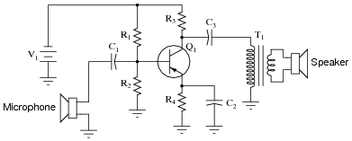
BIASING
Applying DC voltages to the transistor to turn it on so that it can amplify AC signal.
Once the desired DC current and voltage levels have been defined, a network must be constructed that will establish the desired operating point.

Slide 4
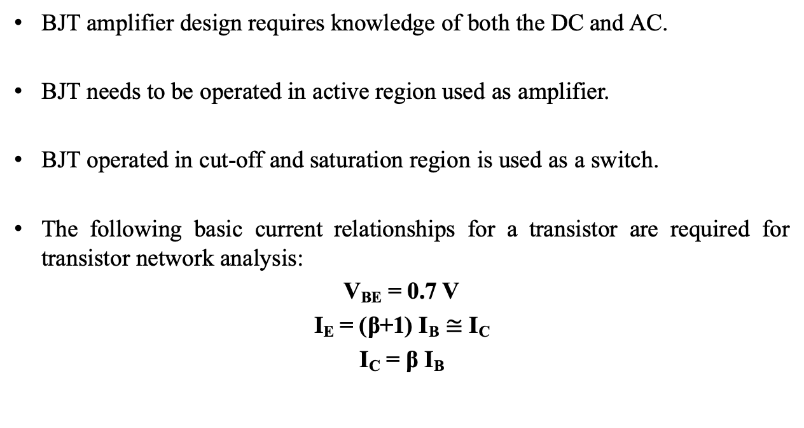
INTRODUCTION
BJT amplifier design requires knowledge of both the DC and AC.
BJT needs to be operated in active region used as amplifier.
BJT operated in cut-off and saturation region is used as a switch.
The following basic current relationships for a transistor are required for transistor network analysis:
V_{BE} = 0.7 V
I_{E} = (β+1) I_{B} $≅$ I_{C}
I_{C} = β I_{B}

Slide 5
INTRODUCTION
Biasing:
Applying DC voltages to establish a fixed level of current and voltage.
The applied DC establishes an operating point (Q-point) that define the region for the signal amplification.
For a BJT to be biased in active operating region, the following must be true:
BE junction = forward biased
BC junction = reverse biased

Slide 6
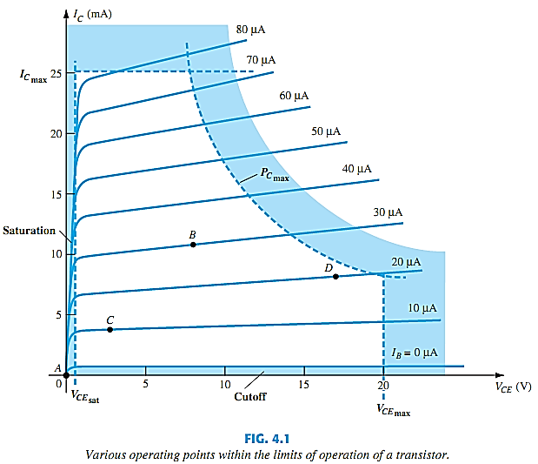
BIASING AND THE 3 STATES OF OPERATION
Saturation Region
Active Region
Cut-off Region

Slide 7
OPERATING POINT (Q-POINT)
Operating Point: Quiescent point or Q-point (static point)
The BJT device could be biased to operate outside the max limits, but the result of such operation would be shortening of the lifetime of the device or destruction of the device.
The chosen Q-point often depends on the intended use of the circuit.

Slide 8
BJT BIAS CONFIGURATIONS
Fixed-Bias Configuration
Emitter-Bias Configuration
Voltage-Divider Bias Configuration

Slide 9
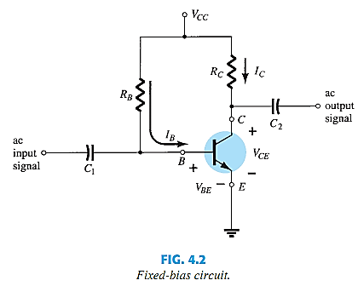
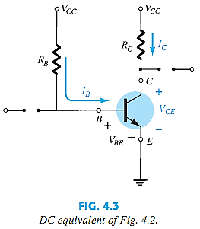
FIXED-BIAS CONFIGURATION

Slide 10
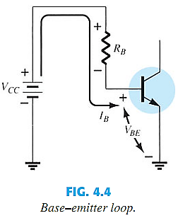


FORWARD BIAS OF BASE–EMITTER

Slide 11

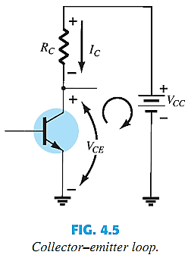





COLLECTOR–EMITTER LOOP

Slide 12
FIXED-BIAS CONFIGURATION EXAMPLE

Slide 13
Transistor Saturation
For a transistor operating in the saturation region, the current is a maximum value for the design.
The highest saturation level is defined by the maximum collector current.
Saturation conditions are normally avoided because the base–collector junction is no longer reverse-biased and the output amplified signal will be distorted.
The resulting saturation current for the fixed-bias configuration is
See Example 4.2

Slide 14
Thank You

